Slide 1
Project:-Student Marksheet program in python programming language
Submitted by :-
Mangesh
Department :- Computer Science & Engineering
Class :-B.Tech Submitted to :-
Dr. Navroop kaur

Slide 2
PROJECT:-Student Marksheet program in python programming language
AGENDA:-
Introduction
importance of marksheet
Purpose of program
Conditions/Logic
Explanation of Program
Code
Output

Slide 3
Introduction
What is a Marksheet?
It is a type of academic transcript that compiles all the marks obtained by a student throughout all the semesters.
An official academic document obtained by students after the completion of a course, reflecting their performance for the same.
It is proof of a student’s enrollment in a college or university

Slide 4
importance of marksheet
Mark sheets indicate your knowledge of the subjects that you have opted for.
It represents what you know at various levels of study.from kg to various standards and exams. Grace marks represent your lack of knowledge and efforts to work in weak areas.

Slide 5
Purpose of program
In this program, we are going to make a simple student mark sheet or mark list
program in a python programming language. Using this program a student can enter their
details. After that based upon the marks, the program can print the mark sheet of the
student that he fails or pass.

Slide 6
Conditions/Logic
Here in the program first we define the ,
subjects list
Subcode list
Two empty list theorymarks and Internalmarks
Two variables count and Mtotal and initialize its values to zero
taking the input from the user
using for loop we are taking the input for the subject marks
and storing them in the theorymarks and internalmarks list using the append method.
Using the print method
Zip function and count
If else statement

Slide 7
Explanation of Program
Here in the program first we define the subjects list in which we define the subject names and then we define a subcode list that consists of subject codes. and then we define the two empty list theorymarks and internalmarks and two variables count and MTotal and initialize its values to zero.
after that, we are taking the input from the user name, fname, number, and college using the input method. after that using for loop we are taking the input for the subject marks and storing them in the theorymarks and internalmarks list using the append method.
after that using the print method we are print the college name, student name, his father's name, and his roll number. and after that, we are printing the subject code, theorymarks, internalmarks, and a total number of marks in a separate line using for loop as you could see in the given below program.
and using the count variable we are finding that if there is any subject for which the total number of marks is less than 44 then we print the FAIL message on the screen. otherwise, we print the PASS message on the screen.

Slide 8
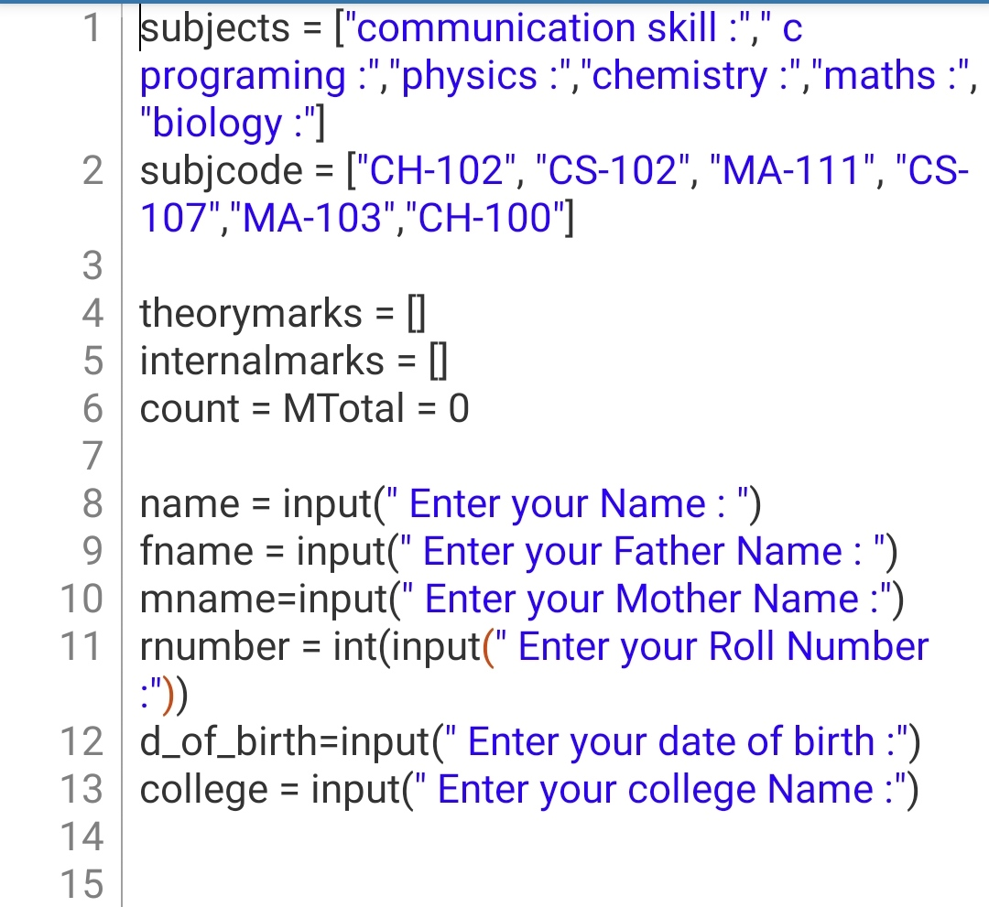
Code

Slide 9
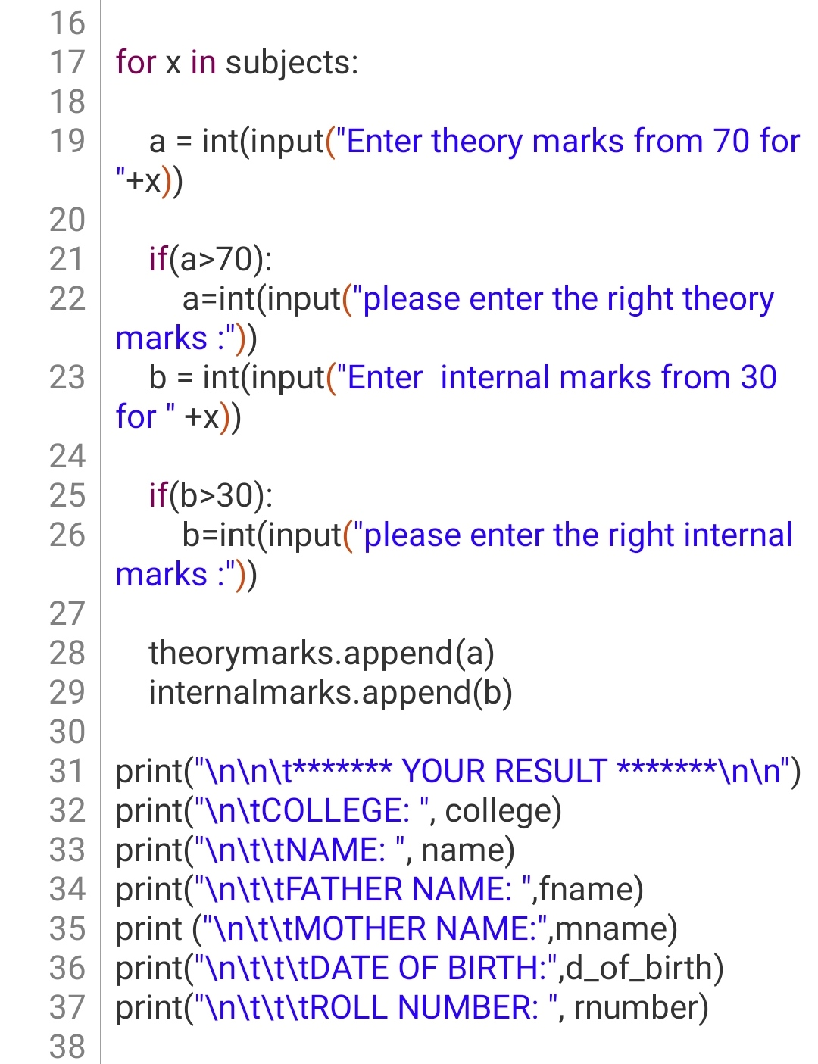

Slide 10
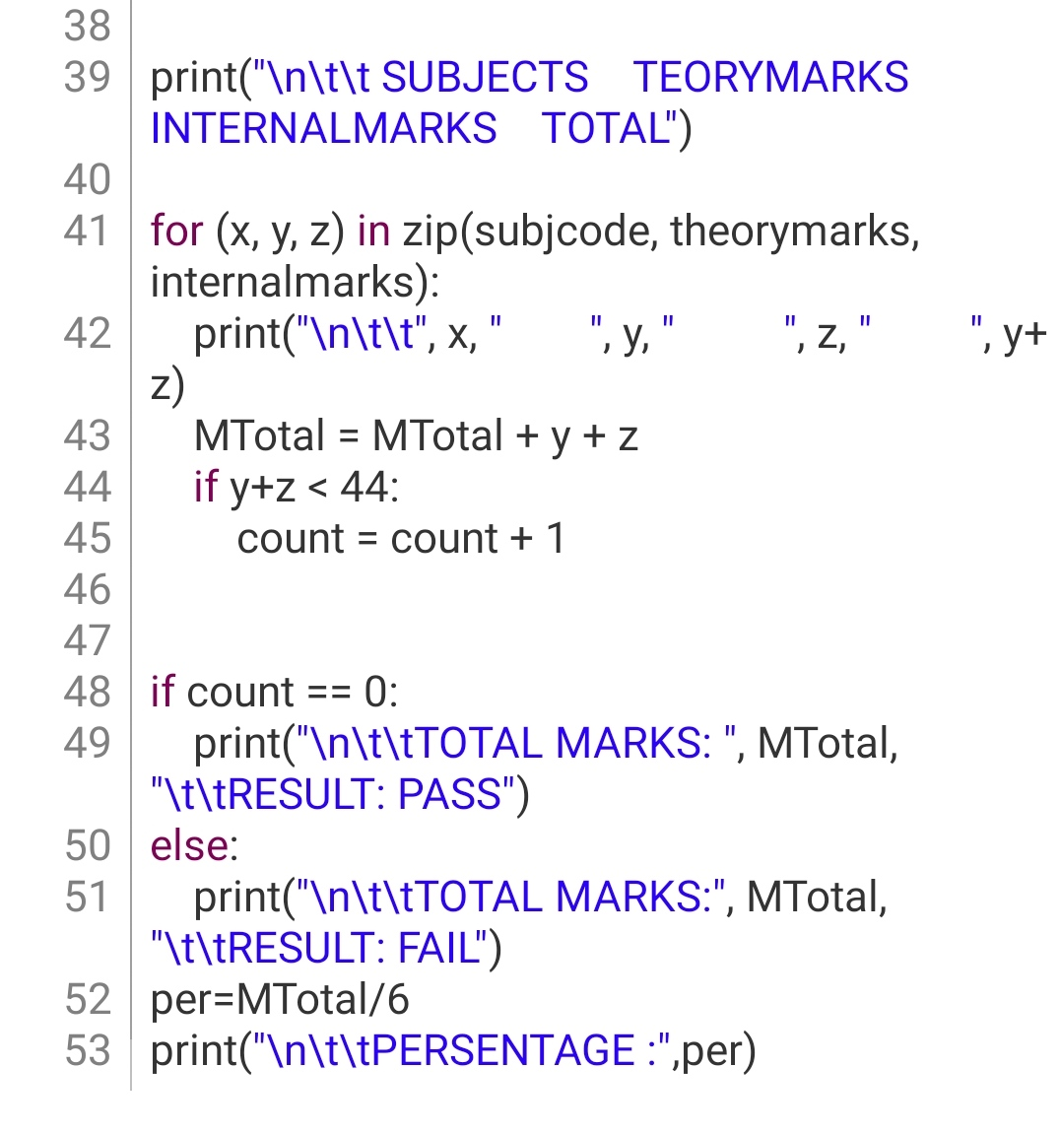

Slide 11
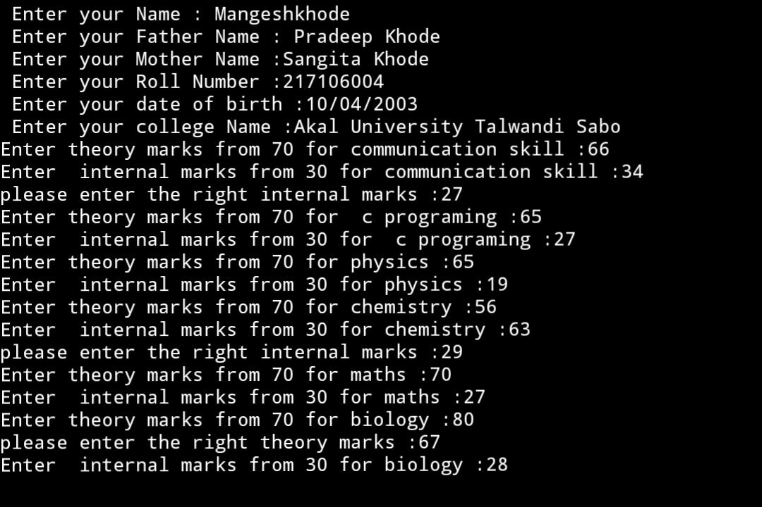
Output

Slide 12
